Slide 1

Retrieval practice protects memory against acute stress
by Amy M. Smith, Victoria A. Floerke, and Ayanna K. Thomas
Science
Volume 354(6315):1046-1048
November 25, 2016
Published by AAAS

Slide 2
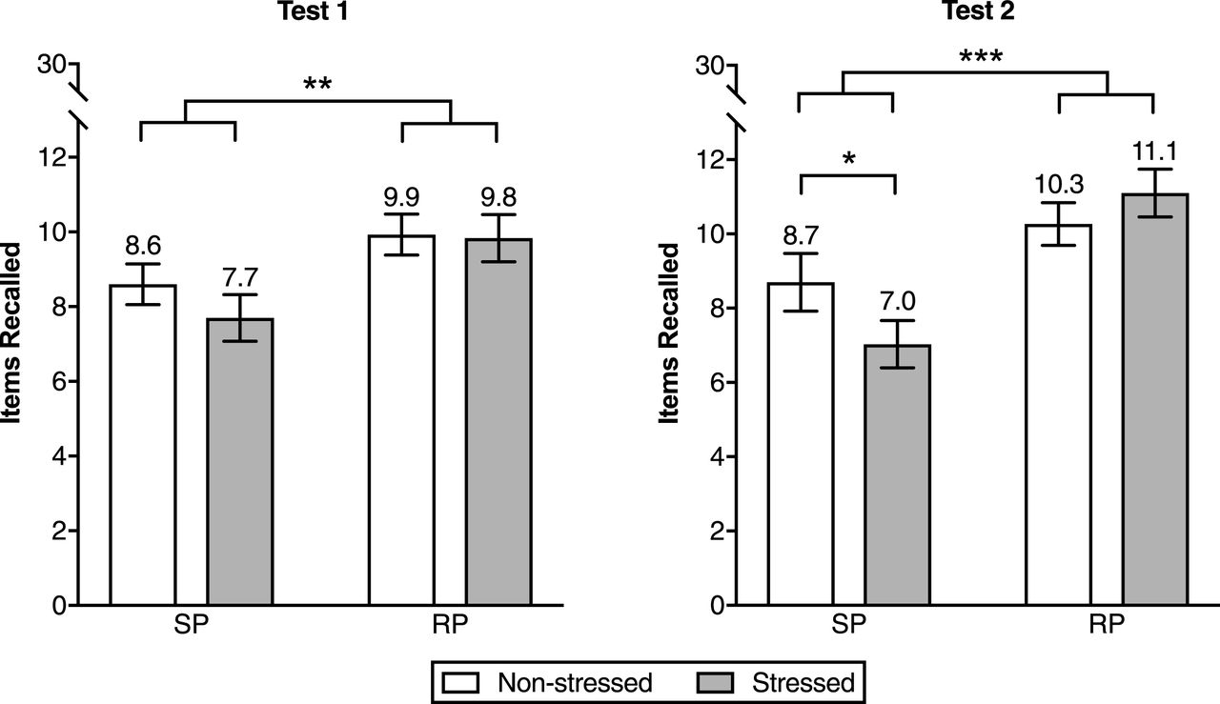
Fig. 1 Average number of items accurately recalled on tests 1 and 2.
Amy M. Smith et al. Science 2016;354:1046-1048
Published by AAAS
Notes:
Average number of items accurately recalled on tests 1 and 2. Test 1 was administered immediately after the onset of stress. Test 2 followed after a 25 min delay. Retrieval practice (RP) refers to the learning technique in which participants study stimuli and take three subsequent recall tests. Study practice (SP) refers to the learning technique in which participants study stimuli four times. Tests occurred on the day after learning. Error bars represent standard errors of the mean. *P < 0.05; **P < 0.01; ***P < 0.001.

